Slide 1



KONGU ENGINEERING COLLEGE
PERUNDURAI ERODE-638060
DEPARTMENT OF COMPUTER
APPLICATIONS
ONLINE FOOD ORDERING PLATFORM
TEAM MEMBERS:
ELAKKIYA D (24MCR022)
AMIYADEVI S(24MCR002)
JOTHI SANKAR E (24MCR047)
SUPERVSIOR
Ms.T.KALPANA /AP
MCA DEPARTMENT.

Slide 2
ABSTRACT
The Food Ordering Platform is a web application developed using the MERN stack(Mongo DB, Express.js, React.js, and Node.js) that provides users with a seamless experience for browsing, ordering, and managing food from various restaurants.The food delivery website is an innovative platform that bridges the gap between customers and local restaurants, enabling users to explore diverse menus, customize their orders and enjoy real time food ordering.Restaurants benefit from enhanced online visibility, access to customer analytics, and tools to optimize operations.

Slide 3
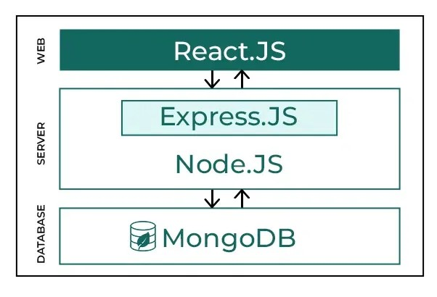
TECHNOLOGIES
Frontend - React.JS
Backend - Node.JS +Express.JS
Database - MongoDB
Figure 1.0 MernWorkFlow

Slide 4
EXISTING DISADVANTAGE
Scalability Challenges
MongoDB may struggle with complex queries and large datasets.
Handling Real-Time Data
Real-time features like order status updates and delivery tracking can be difficult to manage at scale.
Complexity in Data Relationships
MongoDB's NoSQL structure can make handling complex data relationships (orders, users, menus) challenging.
Limited Built-In E-Commerce Features
No out-of-the-box support for e-commerce functionalities like payment gateways, inventory management, or order tracking

Slide 5
PROPOSED ADVANTAGE
Full-Stack JavaScript
MERN uses JavaScript for both frontend (React) and backend (Node.js), enabling a unified development experience and easier collaboration between frontend and backend teams.
Real-Time Data Handling
Node.js, with libraries like Socket.io, supports real-time communication for features like live order updates, customer support chats, and delivery tracking.
Scalability
MongoDB’s NoSQL structure provides flexibility for scaling horizontally, allowing the platform to handle a growing user base, orders, and menu items.
Fast Development Cycle
The MERN stack offers rapid development with reusable components in React, making it easier to build and iterate on features for the platform.

Slide 6
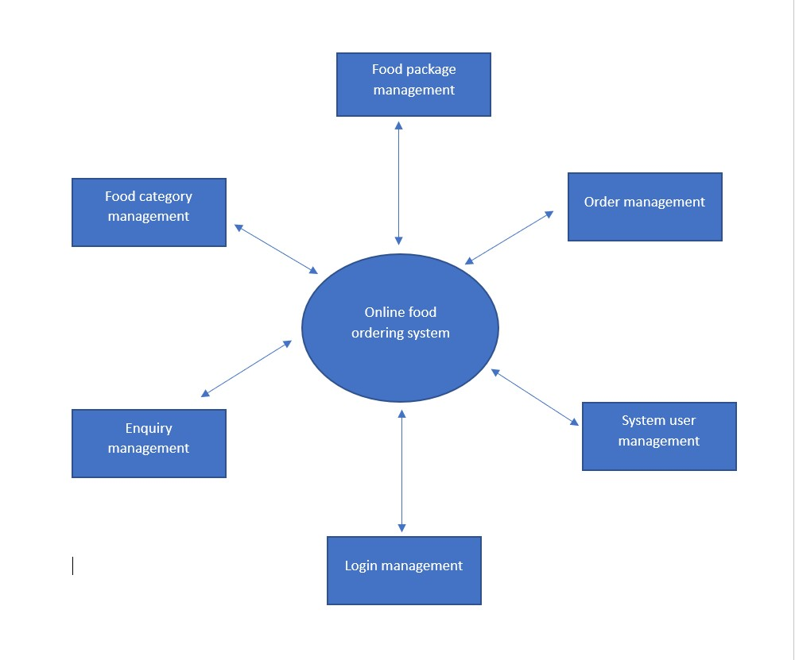
DATA FLOW DIAGRAM
Figure 1.1 0th Level DFD diagram
It is also known as context diagram.Its designed to be an abstraction view showing the system as a single process with its relationship to its external entities. It represents the entire system as a single bubble with input and output data by incoming and outgoing arrows.

Slide 7
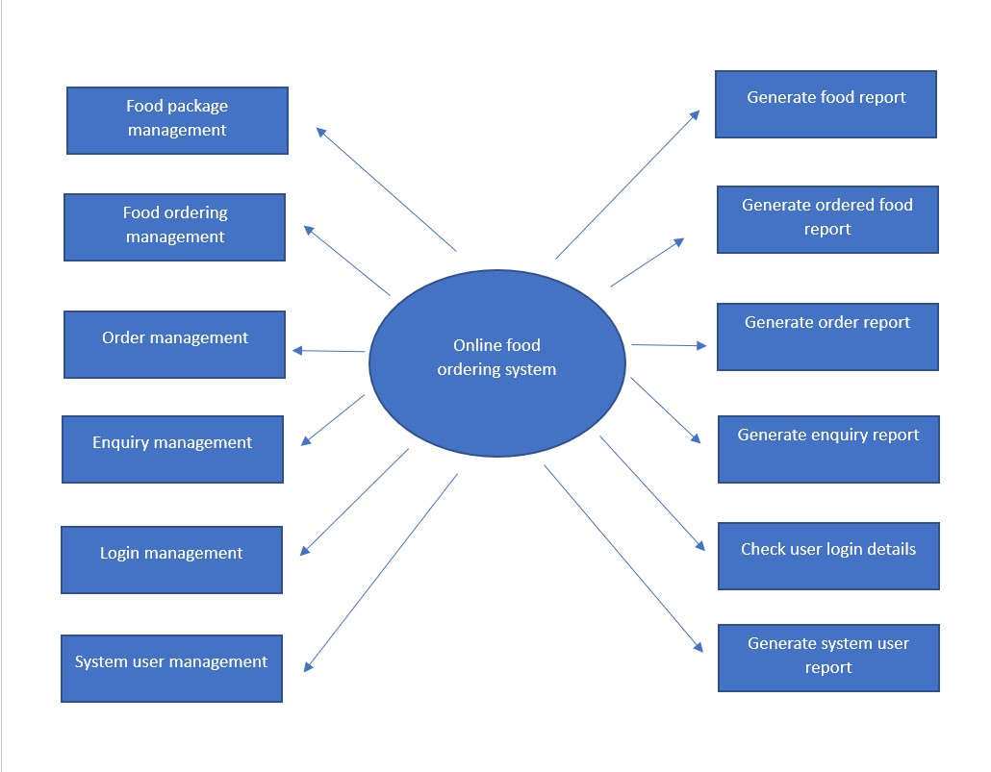
Figure 1.2 1st Level DFD diagram
The Level 1 DFD shows how the system is divided into sub-systems (processes), each of which deals with one or more of the data flows to or from an external agent, and which together provide all of the functionality of the system as a whole. It also identifies internal data stores that must be present in order for the system to do its job, and shows the flow of data between the various parts of the system.

Slide 8
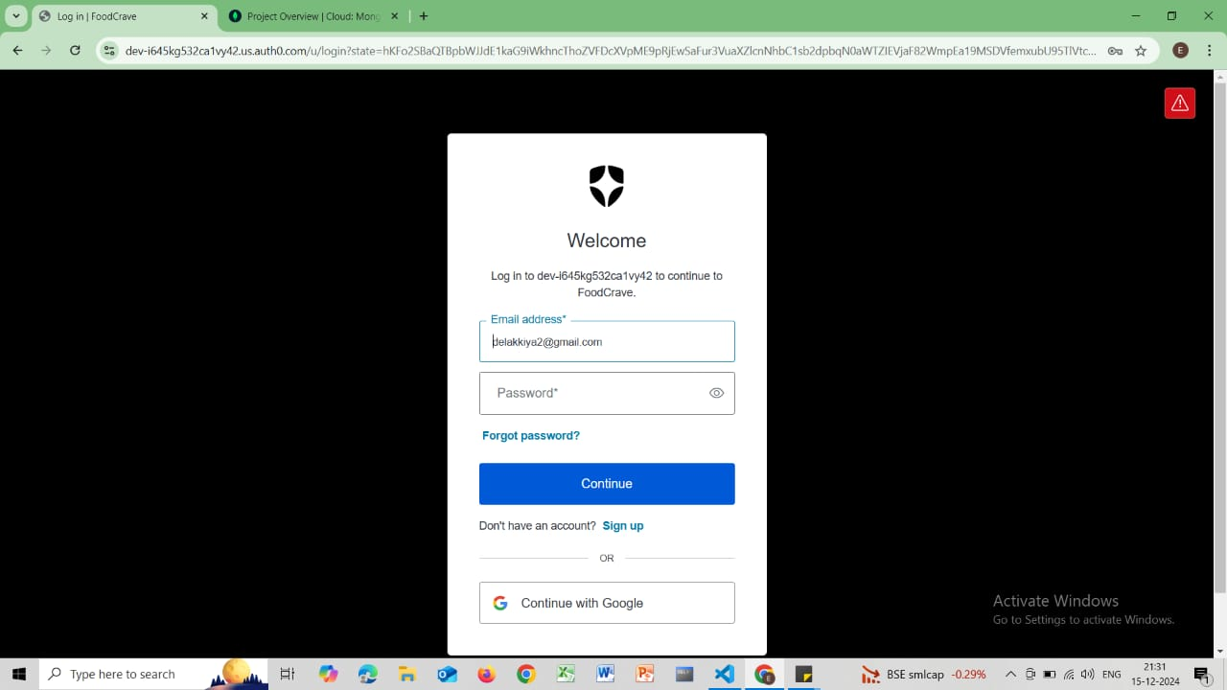
LOGIN PAGE
It features a clean interface with fields for entering an email address and password, along with options for password recovery and signing up for a new account.Users can log in by clicking the "Continue" button after entering their credentials or choose to sign in with Google for convenience. The design is user-friendly, guiding individuals through the authentication process efficiently, whether they are returning users or new to the platform

Slide 9
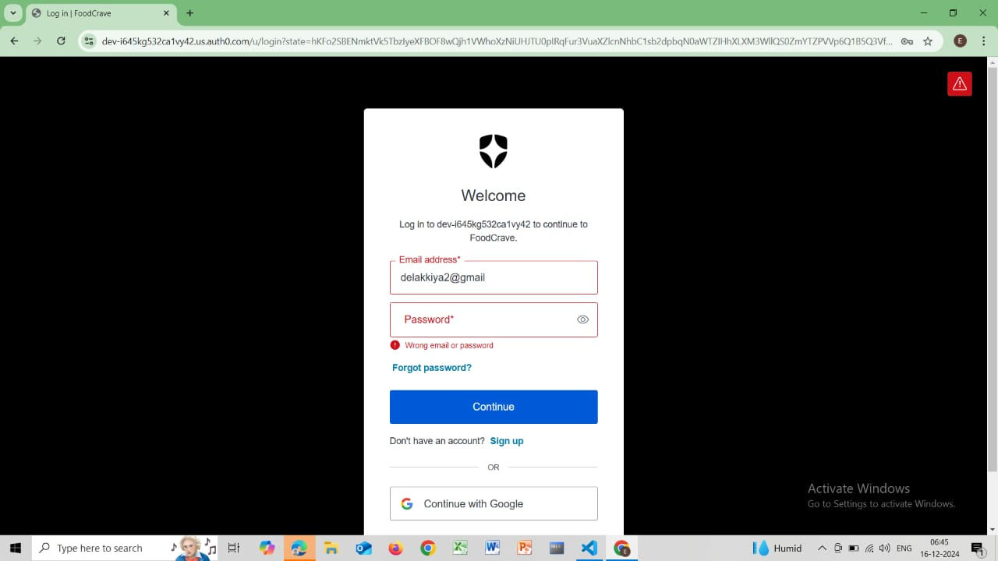
CREDENTIALS LOGIN PAGE
the user enters their email address and password to log in but
encounters an error message stating "Wrong email or password," indicating
incorrect credentials.

Slide 10
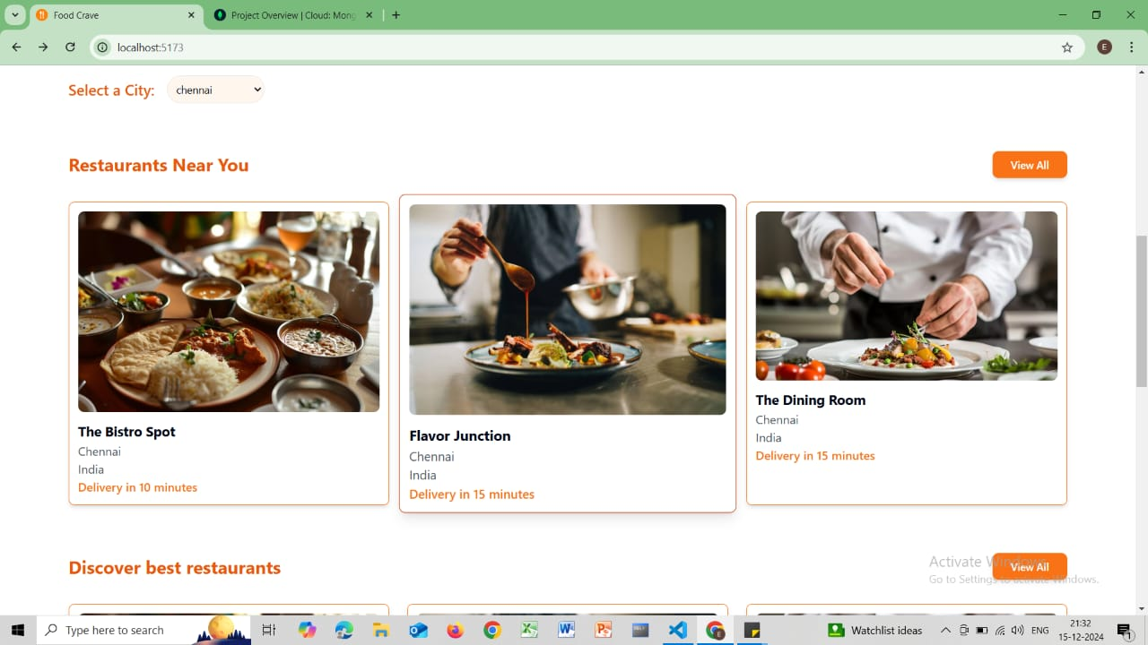
EXPLORE VIEW
The featured restaurants include "The Bistro Spot," "Flavor
Junction," and "The Dining Room," all located in Chennai, India, with delivery
times mentioned (e.g., "Delivery in 10 minutes"). A "View All" button is also
present, allowing users to explore additional options

Slide 11
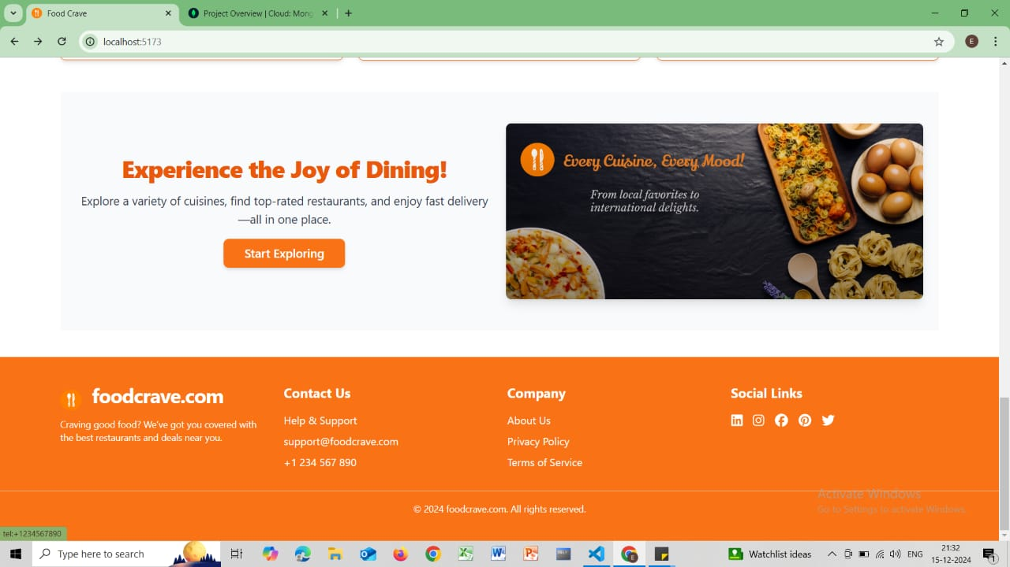
EXPLORE CUISINES
The users can explore the Food Crave website for support, updates, In
Fand deals through features like live chat, social media links, and essential
company details. It invites visitors to stay connected and visit again for a seamless
experience.

Slide 12
CONCLUSION
The Online Food Ordering System successfullystreamlinesfood package management, order processing, user interactions, and reporting, providing an efficient and user-friendly platform for both customers and administrators.
It automates key tasks, reduces manual effort, and generates insightful reports for better decision-making, ensuring secure login and seamless data flow.
The system's modular design makes it scalable and adaptable for future enhancements like real-time tracking, AI-based recommendations, and mobile app integration.
By saving time and operational costs, this project demonstrates how technology can transform the food ordering process while laying the groundwork for innovation and growth.

Slide 13
THANK YOU!

